Slide 1
Graphical Modeling of INFOD applications
Andras Nadas (andras.nadas@vanderbilt.edu)

Slide 2
Outline
Motivation
GME
Models
Workflow
Demonstration

Slide 3
Motivation
Writing well-formed XML files by hand is error prone both syntactically and semantically
Having a model of an application opens new dimensions
Design-time analysis and verification (security, performance, conformance)
Runtime monitoring the Registry
Integrity analysis
Development time Debug functionality
Code Generation for standalone or integrated operation
Lightweight framework without heavy modeling tools
High Quality generated code

Slide 4
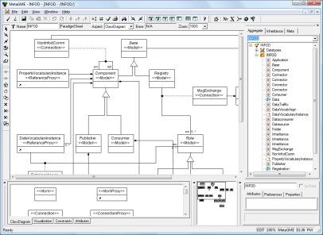
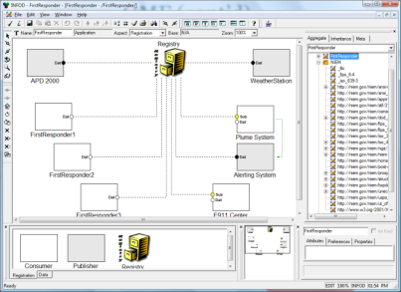
GME Generic Modeling Environment
Domain Knowledge
GME is a meta-programmable toolkit for creating domain-specific modeling environments.
GME models take the form of graphical, multi-aspect, attributed entity-relationship diagrams.
Their syntax is defined by the meta-models specified in a UML class diagram-based notation.
The dynamic semantics are applied by the model interpreters, i.e. by the process of translating the models to source code, configuration files, database schema or any other artifact the given application domain calls for.
GME
Meta-Modeling Environment
Meta-Model
GME
Domain-Modeling Environment
Domain Interpreters
Domain Executable
Domain Analysis

Slide 5
Architectural Model
Two Aspect : Registration, Data
Basic Entities: Registry, Publishers/Consumers
Relationships: Subscriptions, Registration, Data Communication and non-INFOD Communication

Slide 6
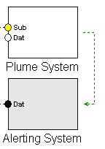
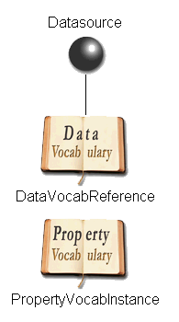
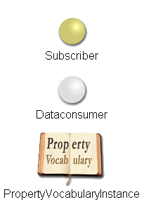
Architectural Model / Vocabularies
Inside of basic Entities
Data Sources/Consumers
PropertyVocabulary Instances
DataVocabulary References

Slide 7
Workflow
Import Language Libraries (Schemas)
Define Vocabularies using Libraries and extensions
Associate Entities with Vocabularies both Data and Property
Create the Entities and Connections in the Architecture
Generate Registration Messages
Generate API code

Slide 8
XML Schemas for Vocabualries
Typical standards used to describe vocabularies in INFOD
NIEM (http://niem.gov/niem)
WSA addressing (http://www.w3.org/2005/08/addressing)
Weather (http://www.weather.gov/forecasts/xml)
Application specific Schemas in Vocabularies
May extend/include other Schemas
Usage difficulties
Complex
Visually not appealing
Reference following is almost impossible

Slide 9
Creating the Vocabularies
Import
Create
Create the Schemas visually
Reuse the imported Elements
Associate
Import Elements or the whole of existing Schemas
Instantiate
UI Support for instantiation
Associate Schemas with Vocabularies

Slide 10
Creating the Architecture Model
Create Entities of the application
Add data sources or consumers
Associate Data Vocabularies
Add a Property vocabulary instance
Determine all the property values
Connect the Entities to the Registry
Create subscriptions by connecting data sources to consumers
1
1.a
2
3

Slide 11
Registration and Instant Creation
Vocabularies used in any of the entities are registered.
Property Vocabulary Instances are created at the time registration
Vocabulary specific UI helps throughout the process
Data connections in the architecture model are converted into Subscriptions

Slide 12
API generation functionality
Using the Model outside of GME
Integration into applications
Entities
Vocabularies transformed into classes
Instantiation thru the API
Registration
Vocabularies are pre defined
Entity instances
Instantiation with UI
Subscriptions

Slide 13
API generation functionality (cont’d)
Generated JAVA API
CASTOR Generated Java classes
Schema Libraries (NIEM etc.)
User Defined Schemas
Registration helper classes
Resource and Network Access
INFOD Base classes
Instantiation Factories/UI
Vocabulary Models
Architecture Models

Slide 14
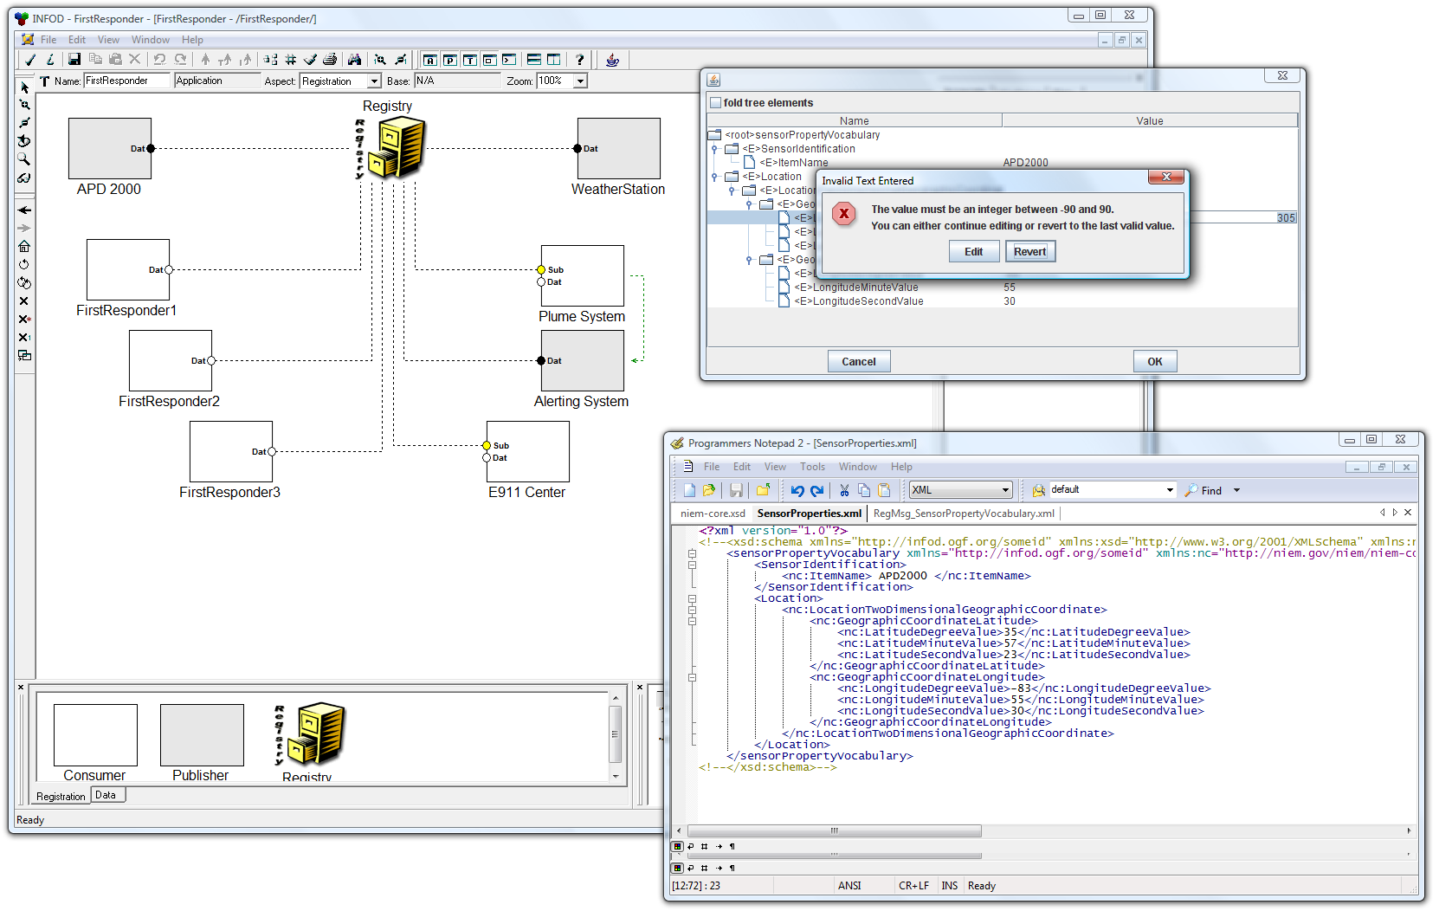
Demonstration

Slide 15
Questions?
Thank you!

